Slide 1
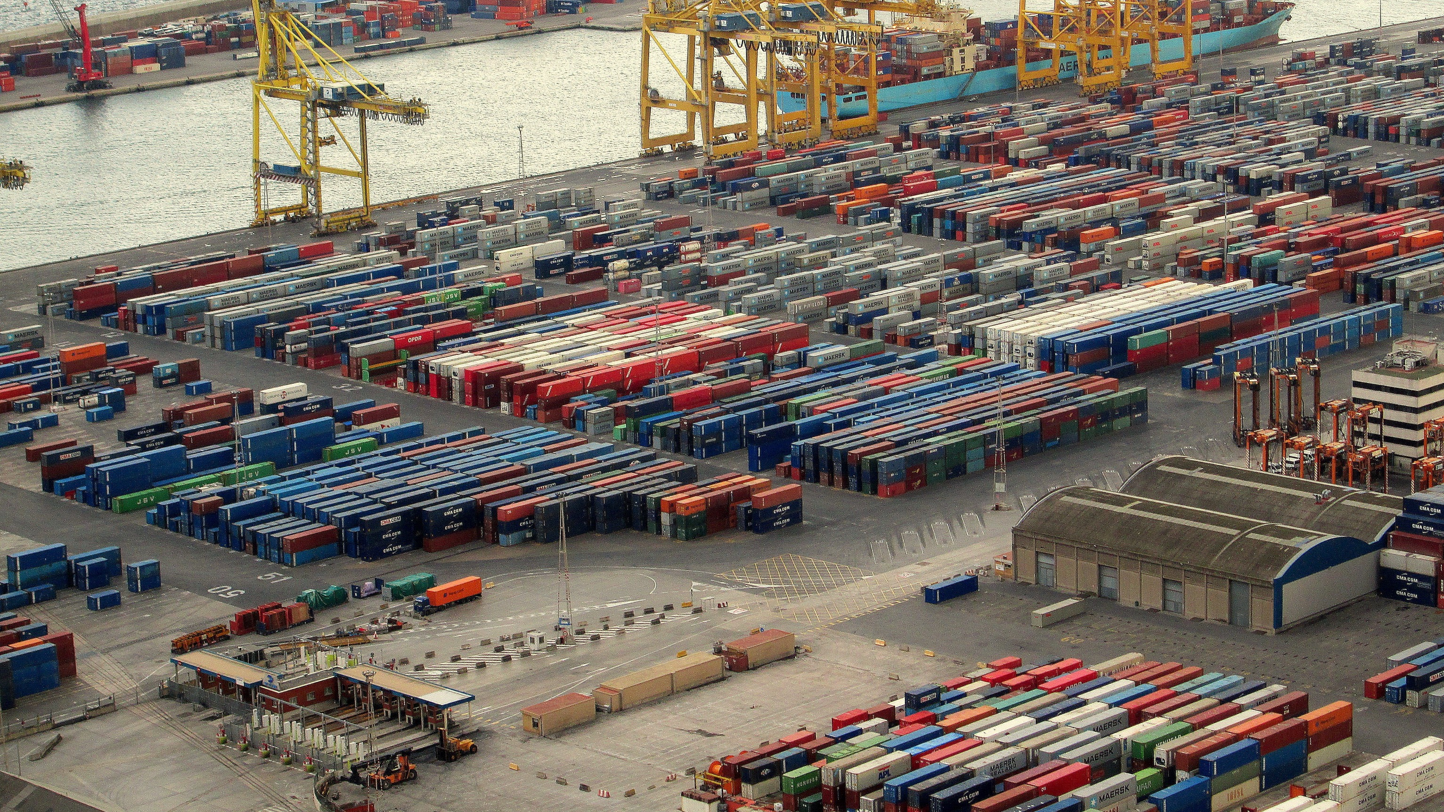


Effect of Covid-19 on Saudi trading
Ahmad Abusabaeen
9/3/2022

Slide 2


How much has the Saudi economy been affected by covid-19?
Lockdown
Shifting to online = Less oil consumption
Thus, lower tendency towards oil imports
Was it a major effect?

Slide 3


Outline
Introduction
Historical overview on exports
Top exports
Effect of COVID-19 on exports
Overview on imports
Top imports
Effect of COVID-19 on imports
Conclusion
This Photo by Unknown Author is licensed under CC BY-NC-ND

Slide 4
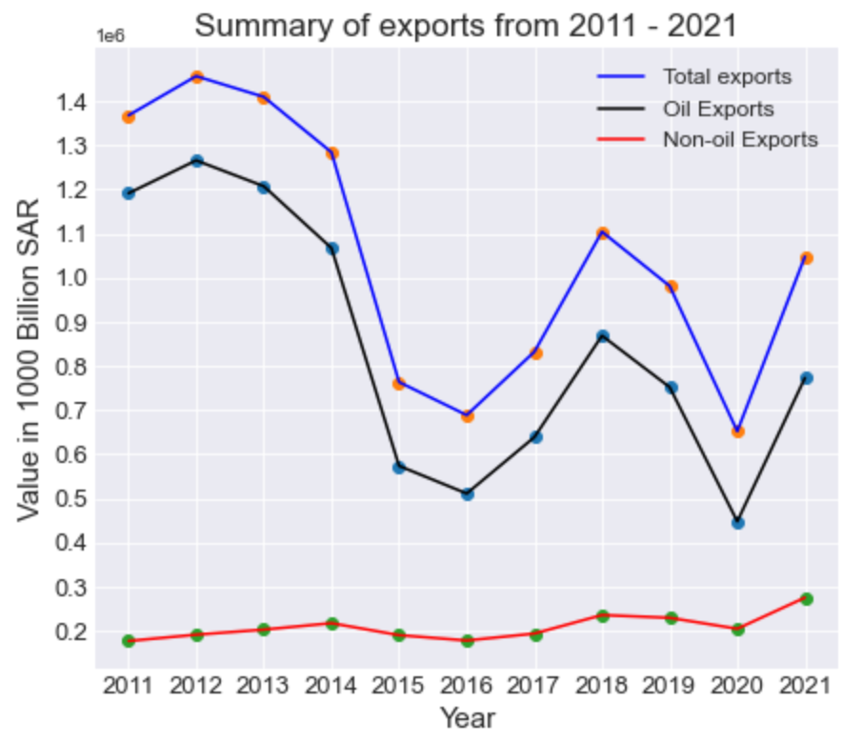
Overview on exports
% 80 of Saudi economy relies on oil-exports
Total exports from 2011- 2021: (SAR 11,586 B)
Oil exports %80: (SAR 9,294 B)
Non-Oil exports %20: (SAR 2,292 B)

Slide 5
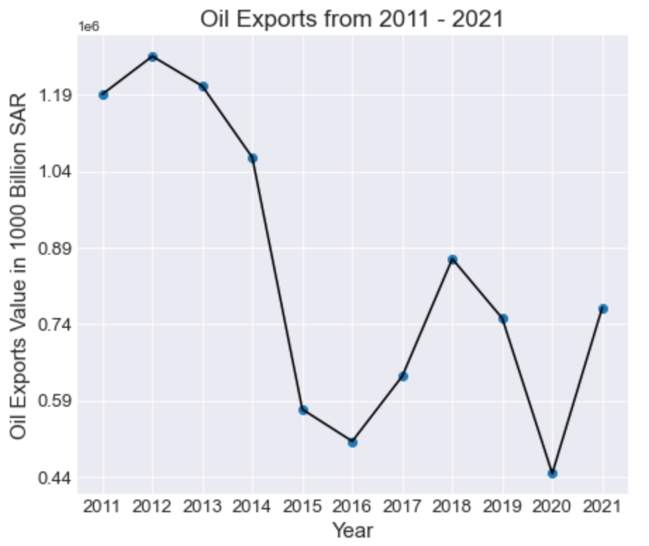
Oil Exports
Highest: 2012
SAR 1265.6 B
Average Price = $ 94
Mean: SAR 1054 B
Mean Average Price = $68
Lowest: 2020
SAR 447.6 B
2020 Average Price = $ 40
Notes:
Lowest oil exports since 2011

Slide 6
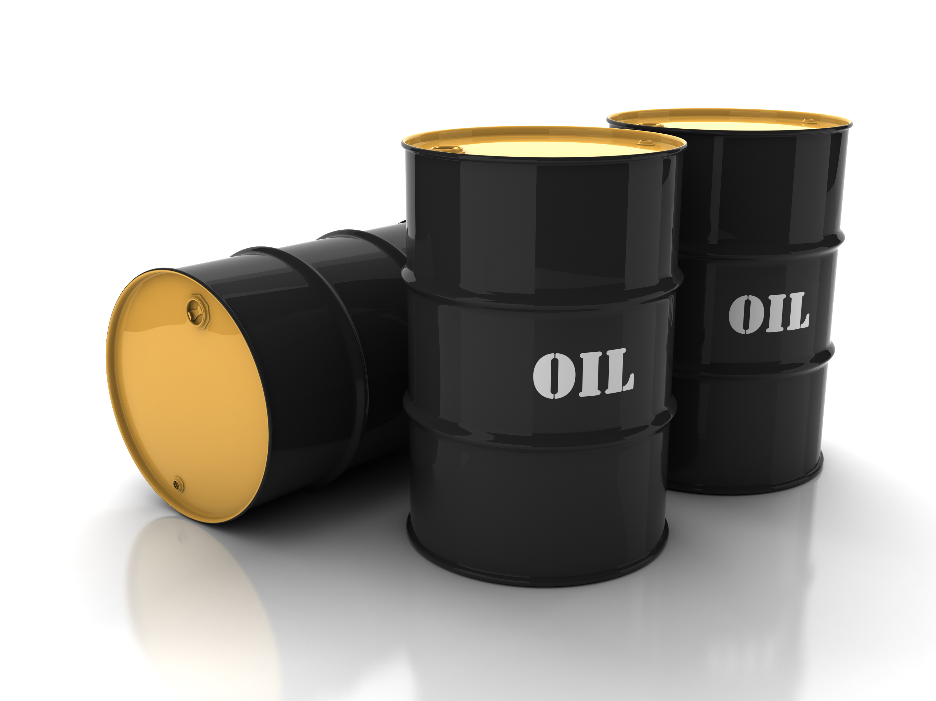
Oil exports
-%40 in 2020 to 2019
-%30 in KSA revenue from oil exports in 2020
+%3 in 2021 to 2019
Notes:
Since %80 of KSA revenues from oil exports, %30 of drop in revenue from oil exports
Less demand on oil since less busy

Slide 7
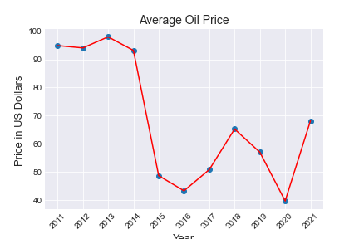
Oil Price
Highest Average Price = $98 (2013)
Mean Average Price = $68
Lowest Average price = $40 (2020)
2019 = $57
2021 = $68

Slide 8
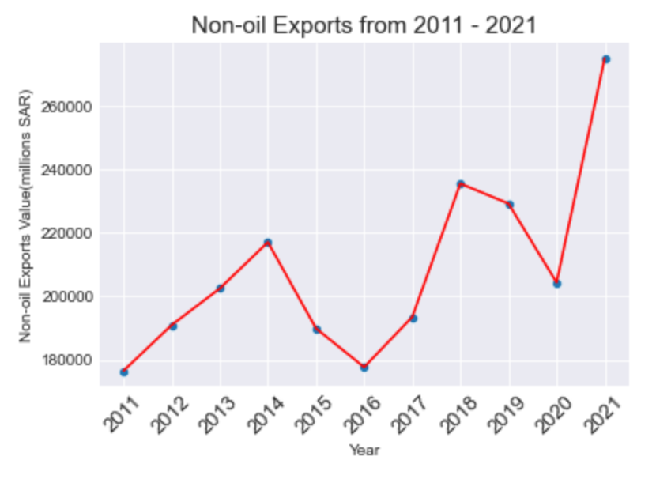
Non-Oil exports
Oil not involved at all
Total 2011 – 2021 = SAR 2292 B
2016 = SAR 178 B (Lowest)
2019 = SAR 229 B
2020 = SAR 204 B
2021 = SAR 275 B (Highest)

Slide 9
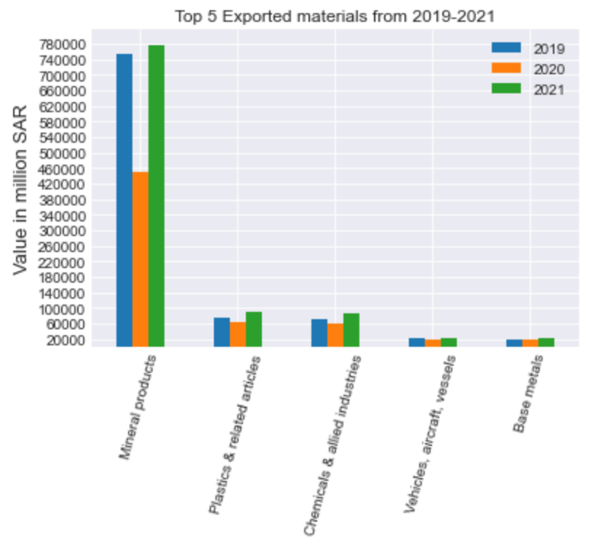
Non-Oil exports 2019-2021
Includes oil products, not crude oil
1st: Mineral Products
-%40 in 2020 to 2019
+%3 in 2021 to 2019
2nd: Plastics & related articles
-%14 in 2020 to 2019
+%20 in 2021 to 2019
3rd: Chemicals
-%17 in 2020 to 2019
+%16.5 in 2021 to 2019
Notes:
Are the non-oil exports increasing?
Yes, and is more than 2019

Slide 10
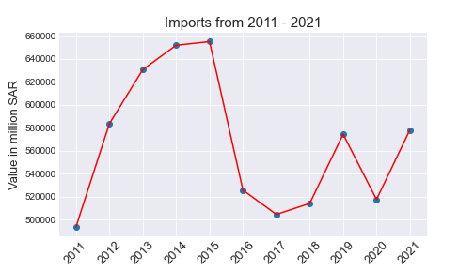
Overview on imports
Total Imports: SAR 6,228 B
Highest: 2015 = SAR 655 B
Lowest: 2011 = SAR 493 B
2019 = SAR 574 B
2020= SAR 517 B
2021 = SAR 578 B

Slide 11
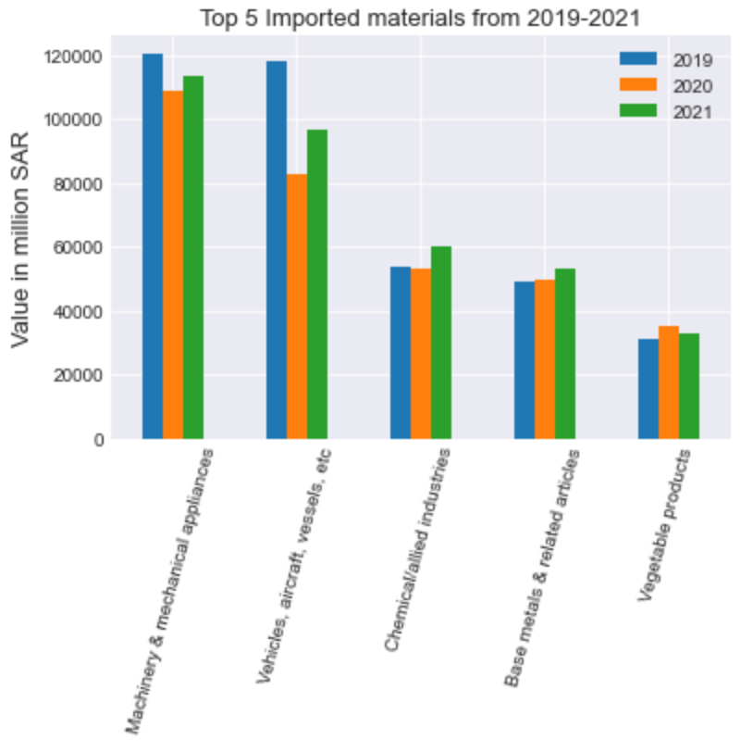
Saudi imports 2019-2021
1st: Machinery, mechanical, & electrical appliances
-%9.4 in 2020 to 2019
-%5 in 2021 to 2019
2nd: Vehicles, aircraft, & vessels
-%30 2020 to 2019
-%18 2021 to 2019
3rd: Chemicals
4th: Base metals
5th: Vegetables products

Slide 12
Why Saudi Arabia?
Member of G20 (Group of twenty world’s leading economies)
Member of OPEC (Organization of the Petroleum Exporting Countries)
World’s second largest reserves of oil.
Strategic location (Asia, Africa, and Europe)

Slide 13

summary
Exports:
-%33 (SAR 329 B) in exports in 2020 compared to 2019
+%6 (SAR 66.6 B) in exports in 2021 compared to 2019
+ SAR 163 B in 2020 from VAT
+ SAR 232 B in 2021from VAT
Imports:
-%10 2020 compared to 2019
+1% 2021 compared to 2019
Notes:
PIF is also another factor that is helping filling in the gap due to covid-19

Slide 14
Problems encountered
UNDERSTANDING the data
Not uniformed data, such as sheets, values, and language
Many sheets to combine and check numbers accuracy

Slide 15
References
https://www.opec.org/opec_web/en/about_us/169.htm
https://www.state.gov/u-s-relations-with-saudi-arabia/
https://www.macrotrends.net/2516/wti-crude-oil-prices-10-year-daily-chart
https://www.statista.com/statistics/1026237/saudi-arabia-vat-revenue/
https://www.datacamp.com/community/tutorials/joining-dataframes-pandas?utm_source=adwords_ppc&utm_medium=cpc&utm_campaignid=1455363063&utm_adgroupid=65083631748&utm_device=c&utm_keyword=&utm_matchtype=&utm_network=g&utm_adpostion=&utm_creative=33260203435

Slide 16

Conclusion
Thank you!

